Slide 1



SUMMER TRAINING PRESENTATION
WEB APPLICATION
ON
RWA COMPLAINT MANAGEMENT SYSTEM
AT
ALL INDIA RADIO
SARTHAK JAIN
09214802716
5-C-5

Slide 2

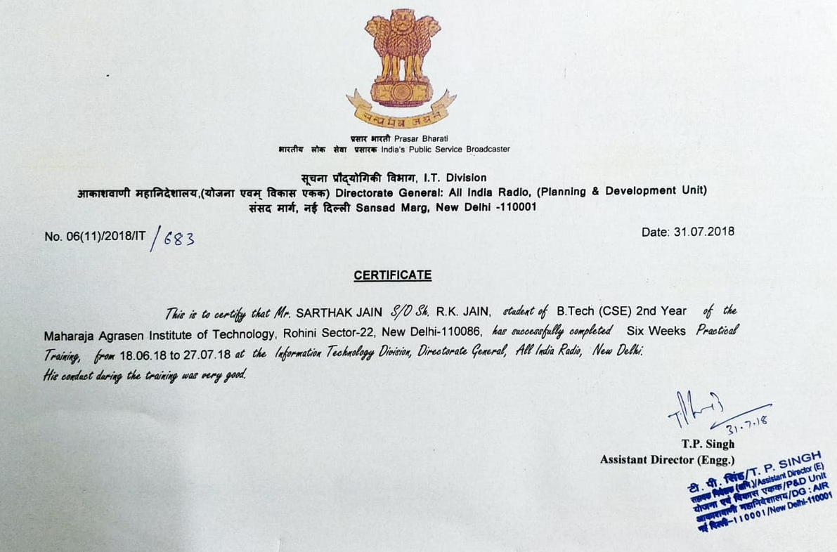

Slide 3

RWA Complaint Management System is a project that evolved from an idea to help the residents. The residents of Radio Colony, Kingsway Camp can a make an online complaint through our website.
Here, the complaint are classified as Civil and Electrical . These different categories of complaint are taken care by two separate hierarchy of officers viz JE(E), AE(E).
RWA Complaint Management System in layman terms is a website consisting of multiple web pages that can be accessed and allows the user to connect to other residents of their colony

Slide 4
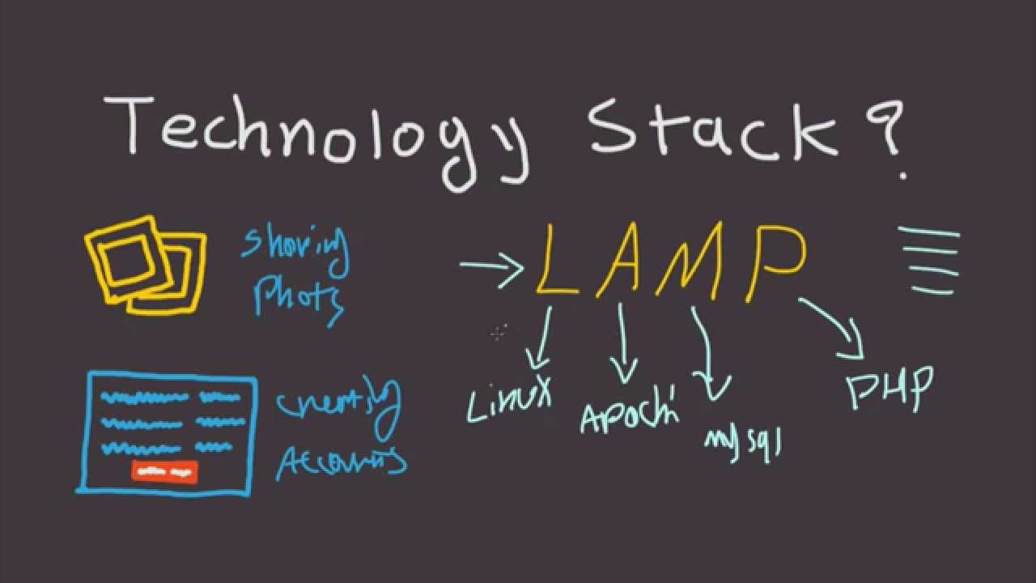







Slide 5
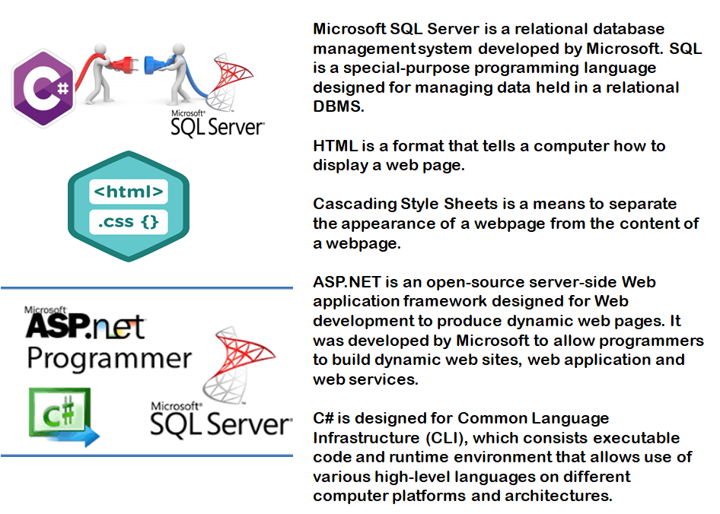

Slide 6
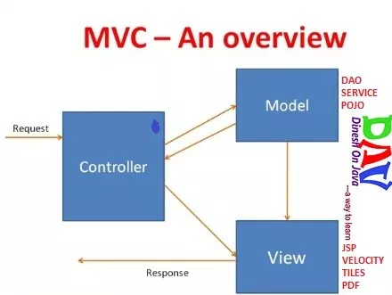
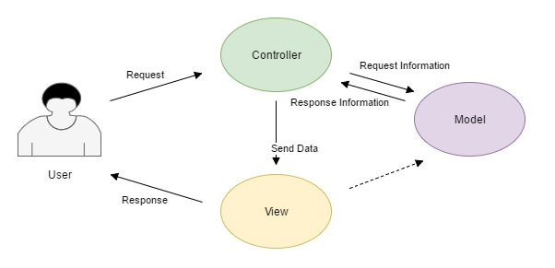
MVC Architecture
1.Faster development process
2.Ability to provide multiple views
3.Support for asynchronous technique
4.Modification does not affect the entire model
5.MVC model returns the data without formatting
6.SEO friendly Development platform

Slide 7

Functionalities
Login Capabilities
User must enter his username and password that he made during the registration procedure.
Login Session
The users can logout after being active on the site for a specific duration of time. This is a security layer that can be helpful in several scenarios.
Usability
Users have to access the system from the Internet using browser. Since all concerned users are familiar with the general usage of browsers, no specific training is required.it is user friendly and self-explanatory.
Reliability
SYSTEM intends to be independent and fault-tolerant. When it comes to cyber attacks and unethical hacking, we at RWA COMPLAINT MANAGEMENT SYSTEM aim to provide full proof security measures to counter attacks and prevent them from happening .

Slide 8
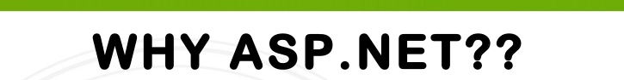
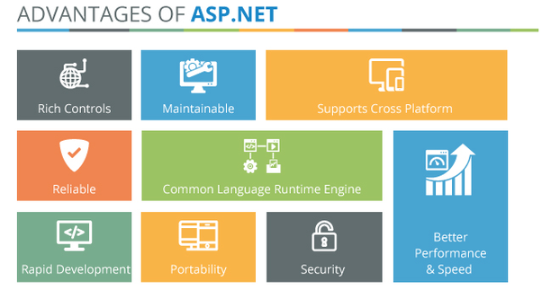
There are multiple scripting languages in which web pages can be created. We worked on ASP.NET since ASP.NET is a basic implementation of the .NET Framework over variety of Internet services and the websites and they run on the same server. Majority of existing companies continue to use ASP.NET as it gives an individual greater independence and control over a variety of elements that make web pages. What made ASP.NET ideal for COMPLAINT MANAGEMENT is the fact that ASP.NET is economical, provides higher scalability options and has provisions for inbuilt security features such as authorization and authentication along with a plethora of others.

Slide 9

The user has to first register himself/herself by clicking on Sign up button and filling all the required details. After verified by the admin, the user can log in to the website by entering their respective email id and password entered during registration time. After log in, user can register their complaint and check the status of it by clicking on All Complaints button. ​
Beside user page, there is admin log in, who is authorized to view all complaints and manage the status of complaints. Administrator authorize a user after registration. On home page there is contact option also in which, the details of the person to be contacted is given in the case of any trouble.​

Slide 10

RWA COMPLAINT MANAGEMENT SYSTEM has been developed to provide the people involved with it to know about the day-to-day activities in their society. RWA COMPLAINT MANAGEMENT SYSTEM website has the following features:
1. RWA COMPLAINT MANAGEMENT SYSTEM provides the facility to add members to the group anytime.
2. RWA COMPLAINT MANAGEMENT SYSTEM provides admin with the option to check the designation of any member and change it if needed
3. RWA COMPLAINT MANAGEMENT SYSTEM allows members to upload relevant details of any event coming up.
4. We have a database that contains all the information of registered members like their name, address, designation, age, username and password for the account created. events and functions happening at colony.
5.We also have another database designed that stores the information about the complaints filed and their status by respective officers.

Slide 11

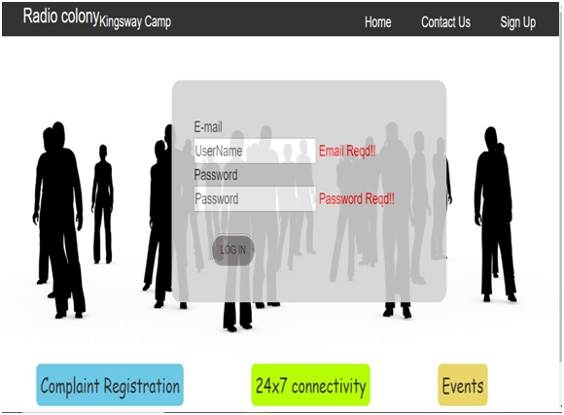

Slide 12

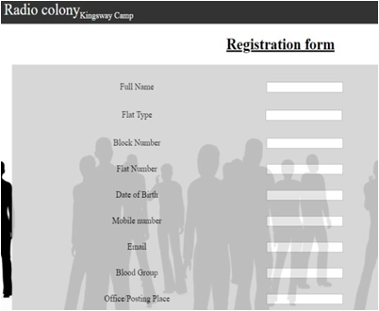
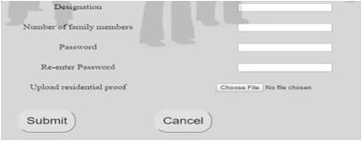
Signup: Sign up page allow a user to register themselves by entering personal details and creating password.

Slide 13

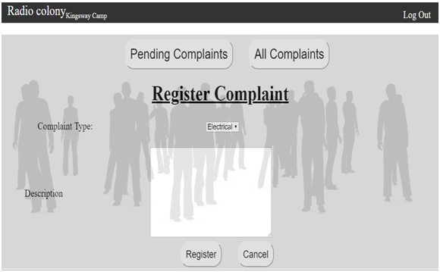
Complaint: This page allows opens after successful log in and the user can register their complaints.

Slide 14
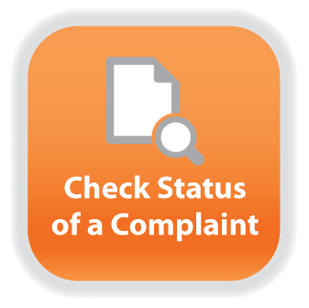
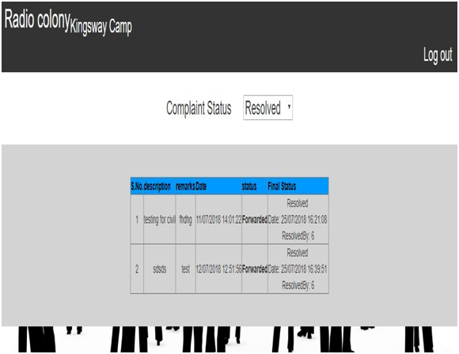
Complaint Status: complaint page shows the user their complaints list and the status of their complaint.

Slide 15

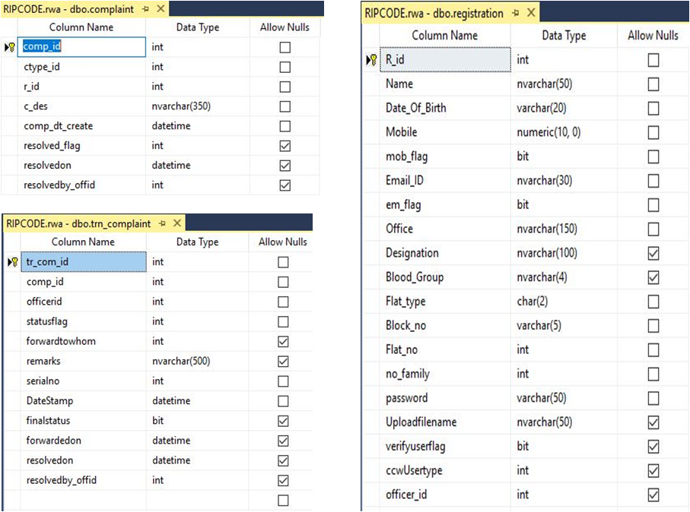

Slide 16

What did we talk about?
Work Place- company profile
Tasks performed
Technologies used
What did I learn?
Technical job
Office regulations
New technologies in market
Work culture
Timely submission before deadline

Slide 17



